Slide 1
Final Presentation Langley Park Dashboard
John Davitz, Jason Doh, Julian Gonzalez, Xijing Chen

Slide 2

Our Project - Data Dashboard Enhancement
Details on the Project Context
Langley Park Civic Association, Inc. serves the community of Langley Park, an area that lacks a certain directory of infrastructural and informational resources.
Challenge for residents — Accessing information
Previous Team — Static Excel directory
Point of Contact
Norberto Martinez
Solution / Specific Use Case
Search & Filters (27 categories)
Notes:
The Langley Park Civic Association serves the community of Langley Park, an area that lacks a certain directory of infrastructural and informational resources. A significant challenge for residents is accessing up-to-date information about local, county, state, and federal resources, which can help improve their living conditions. The lack of an effective and easily navigable directory means that many residents are unaware of the assistance available to them, leading to underutilization of resources and services that could significantly enhance their quality of life.
Previous team of the project provide the Langley Park Civic Association a static resource directory that was not user-friendly because it was hard to share with residents. It also has no integration on their main website. The inefficiency of this system placed a burden on the staff, particularly our client contact, Norberto.
So our team needs to enhance this dashboard. Consider the use case of a local resident seeking information on different available services. Previously, the client and residents might spend considerable time searching through outdated listings, or might have to call LPCA directly. With our interactive dashboard, they can now quickly find the most current information that offers search and filter functions. For instance, they can filter services by category, including groceries, dental, legal, job training etc.

Slide 3
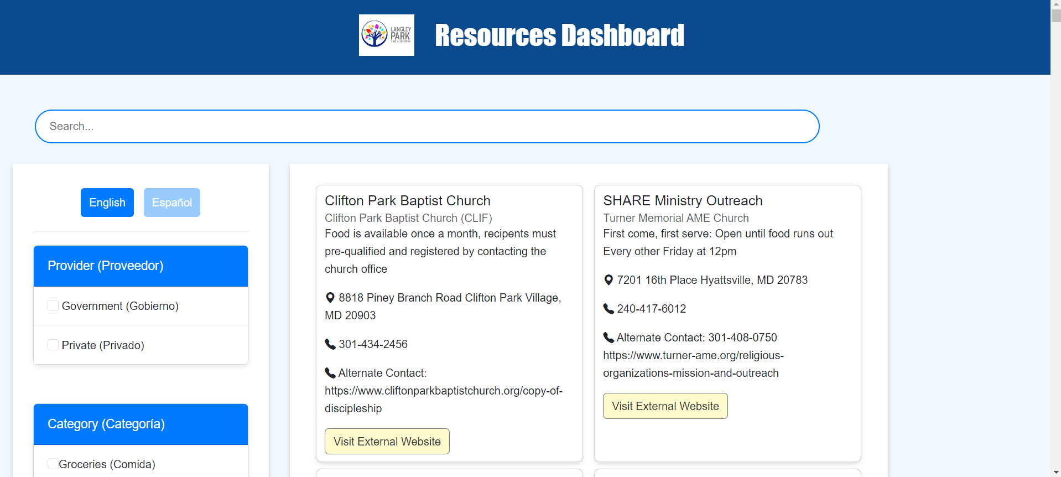
The Directory/Dashboard
Live Demo: https://langley-park.vercel.app

Slide 4

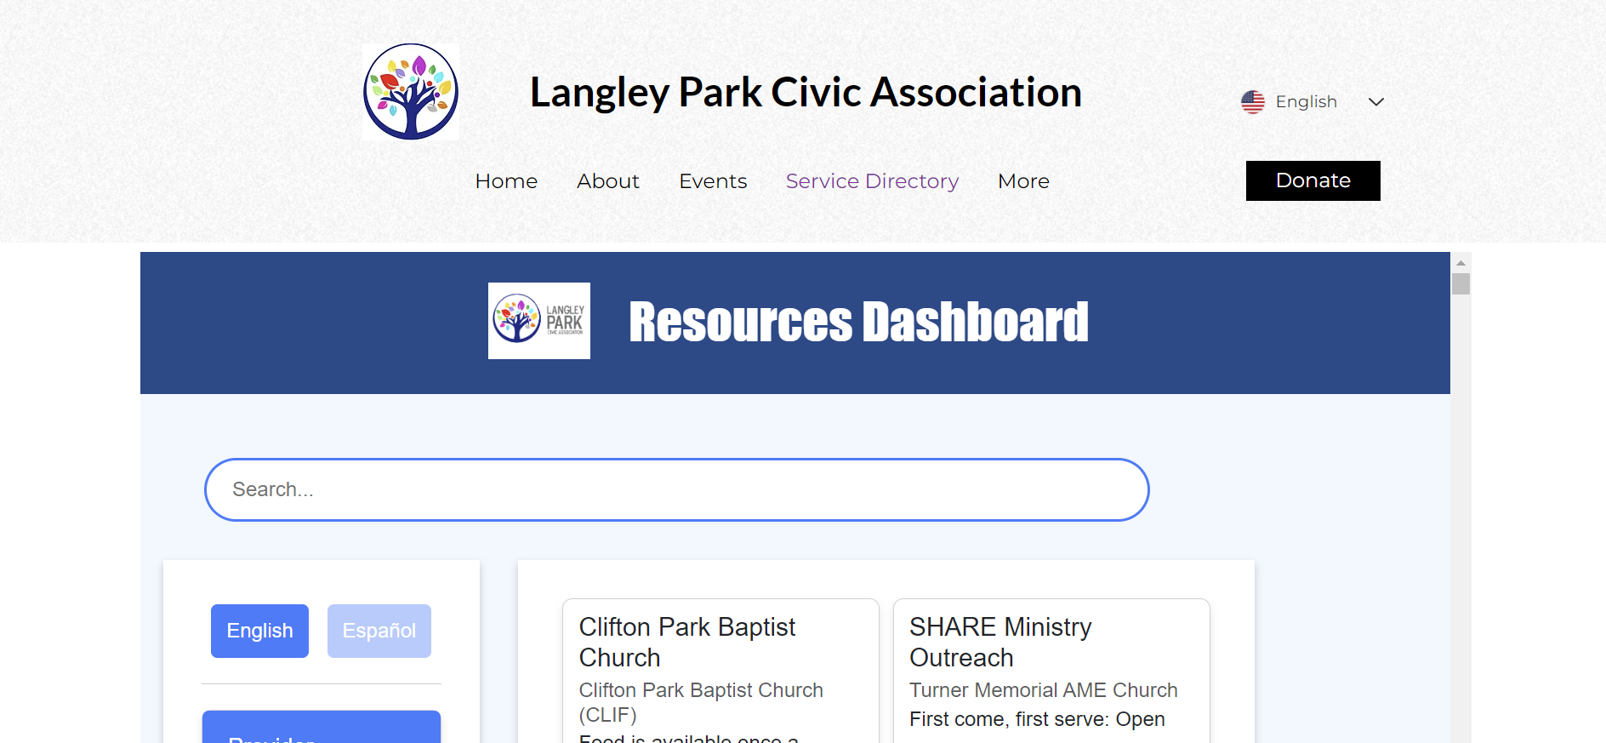
https://www.langleyparkcivic.org/programs-and-services

Slide 5
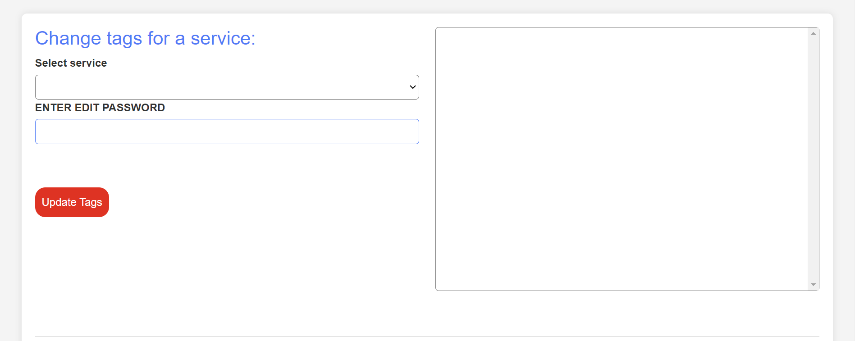
Editing/Updating Dashboard
01 Change Tags

Slide 6
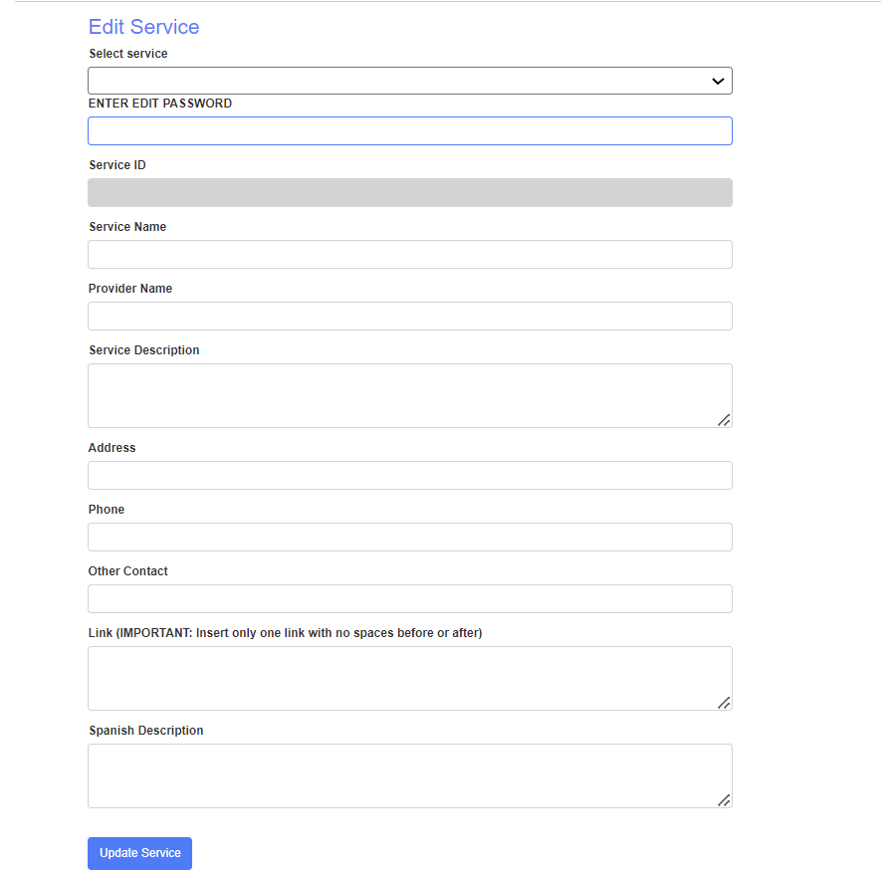
Editing/Updating Dashboard
02 Edit Service

Slide 7
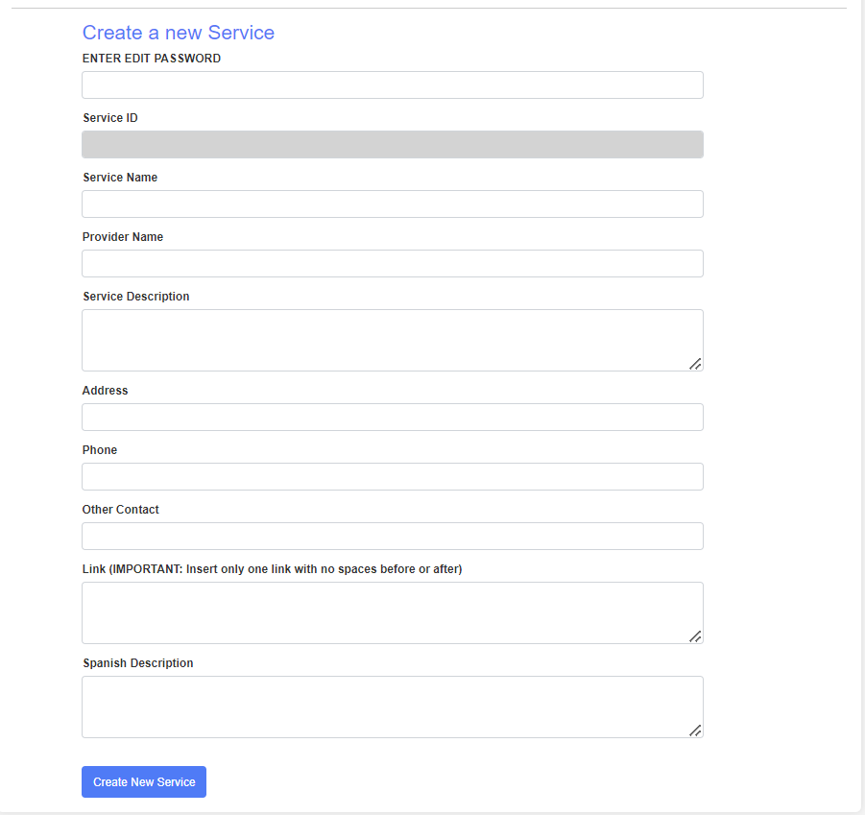
Editing/Updating Dashboard
03 Create a new Service

Slide 8
Final Deliverables
Dashboard
Maintenance Document
Github
Data
Link
Others
Document
Account/Password for Editing
Report
Contact Information
How: online repositories and emails
When: May 8 / May 15
Notes:
Dashboard
GitHub: Repository containing all source code and project files.
Data: Organized and cleaned dataset we used in the dashboard.
Link: Direct URL to the live dashboard, accessible online.
Maintenance Document
Document: Comprehensive guide detailing how to update, maintain the dashboard, and manage the content directory. Includes information on service categories and community demographics.
Account/Password: Credentials for accessing the dashboard’s backend or content management system.
Others:
Report: A detailed report describing the dashboard development process, UI enhancements, multilingual support, and client-specific branding integration.
Contact Information: Key contact details for ongoing support or queries related to the dashboard.
How: Through online repositories (Github, Google files) and emails that contain detailed documentation and direct links for easy access.
When: Presentation with our client was on May 8th. We will upload final report and deliverables by May 15th.

Slide 9
Project Status
Jan | Feb | Mar | Apr | May
Tasks Phases | Details / Description |  | Date |  | Status
Planning Phase | Team setup, project planning, and initial meetings to outline the project's scope and deliverables |  | Feb 5 - Feb 26 |  | Completed
Design & Work Phase | Development of a dashboard mockup, data organization, translation, and the actual dashboard |  | Feb 27 - Apr 26 |  | Completed
Test Phase | Gather feedbacks, final refinements, and final presentation to stakeholders |  | Apr 27 - May 12 |  | Completed
Project Planning and Setup
Design and Actual Development
Test and Organize
Notes:
We began with our project planning in February. During this phase, we had several meetings to outline our project's scope and determine the deliverables.
From the end of February to April, it is our design and actual development phase. This involved creating a mockup. We then organized the necessary data, translated content to make the dashboard accessible, and developed the actual directory.
From the end of April to May, Test and Organize phase:
It was dedicated to refining our product. We gathered feedback from our clients to make necessary adjustments and prepared for the final presentation to our stakeholders
As you can see, each phase of the project has been marked as completed, indicating we finished our project on time.

Slide 10
Future Plans
New Language Options
Expansion to other languages:
French
Japanese
Etc.
Website Integration
Unified Language Settings: Currently, the dashboard and the website operate with a disjointed language system.
Notes:
To make the dashboard more inclusive and accessible, future plans can have adding support for additional languages such as French and Japanese. This will definitely include more audiences and users.
Currently, the dashboard and the website operate with a disjointed language system. When a user changes the language setting on the website, the dashboard language remains unchanged, requiring the user to make a separate adjustment. So unified language settings could be another plan.

Slide 11
Thank you!
You can enter a subtitle here if you need it

